Slide 1
How to Present your Paper/Research
GRDS Conference Secretariat

Slide 2
The paper may be presented in any of the three modes
Oral
Poster
Video

Slide 3
Oral Presentation
We encourage our participants to adopt a crisp 10 Minutes Presentation Format.
1 Minute: Self Introduction and Topic
2 Minutes: Problem Area/ Need of Research
2 Minutes: Inputs/ Efforts/ Methodology
2 Minutes: Outputs
1 Minute: Take Aways
2 Minutes: Discussion
This format is tried and tested, and makes the sessions very meaningful, rather than monotonous and full of slumber. Knowledgeable participants, but with poor soft-skills also find it easy to present. This format provides more time for networking and discussions and idea sharing, which are the core purpose of our conferences.

Slide 4
Poster Presentation
All you have to do is to make a poster on soft copy/hard copy.
We would project the soft copy on the LCD projector for 5-10 minutes. If the author brings the poster, we would be attaching it to the board for its display.
If anybody has some queries they may ask you to clarify.

Slide 5
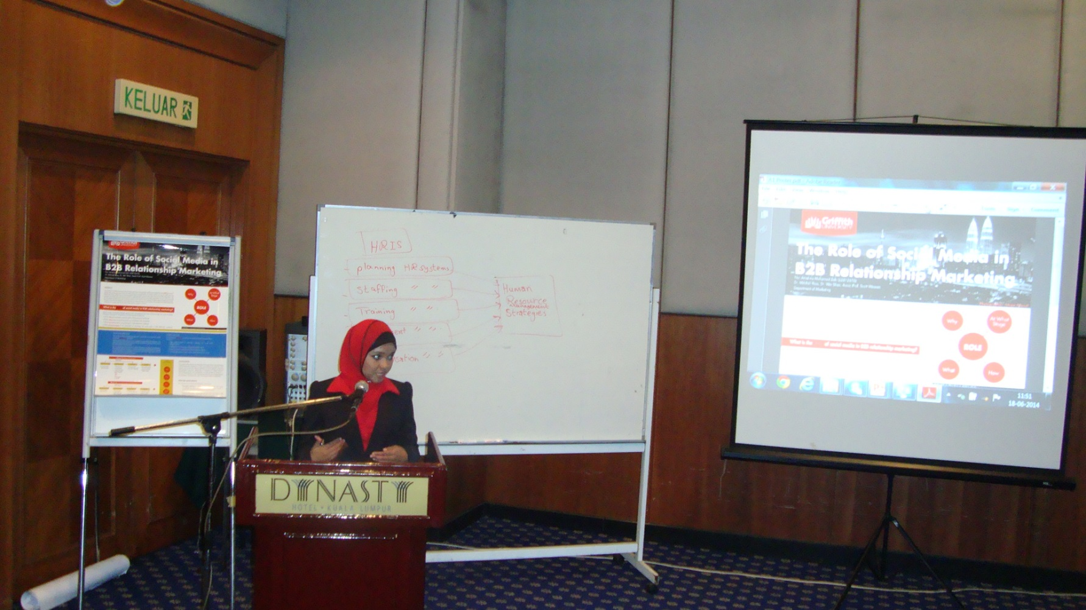
Sample Poster
Download sample poster by double clicking on the icon

Slide 6
Video Presentations
You may just make a video of presentation
The presenter may be:
The author/co-author
Your colleague/friend
Please make sure that it is audible/ interesting /understandable.
This would be run on the projector with audio speakers
You may record on your HD Phone/ Camera in a closed room with proper lighting, any friend/ colleague/ expert to present your research in our unique 10 minute presentation format

Slide 7
Any queries please email on
info@grdsweb.org

